Slide 1
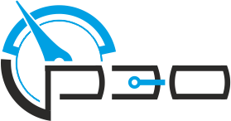




Russian Electrotechnical Company Limited
Advanced solutions for generation, conversion , distribution, storage of electrical energy for shipbuilding, transport infrastructure, energy, oil and gas and other industries
ruselco.com

Slide 2

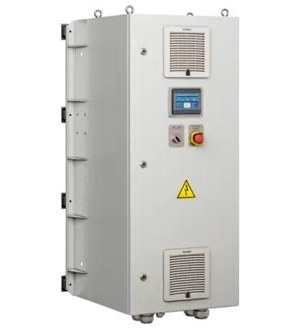
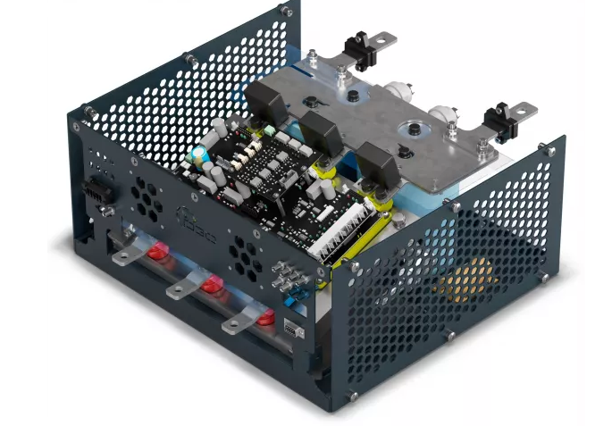
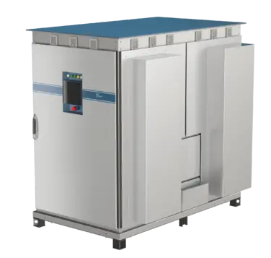
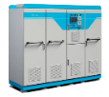
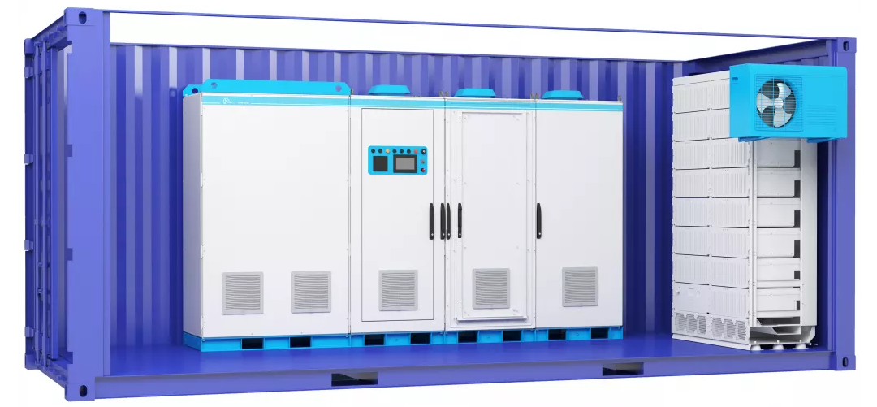
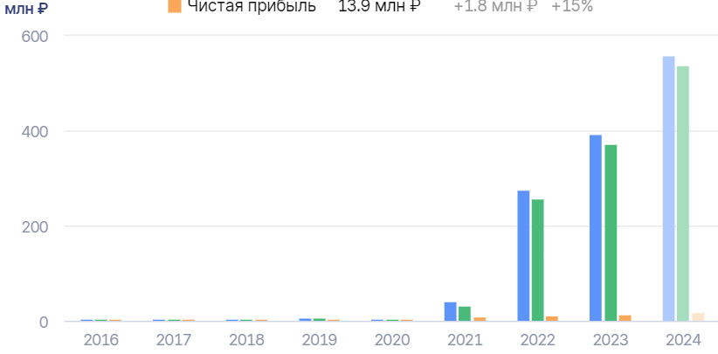
ABOUT COMPANY
History of the company's development
2024
Creation of a 0.4 kV frequency converter "PAPIR" with a power range from 1 MW to 5 MW
2020
Creation of a 0.4 kV frequency converter "PAPIR" with a power range from 1 MW to 5 MW
2022
Creation of a UPS with a supercapacitor storage for a data center with a capacity of 2.4 MW
2016
2018
Creation of a 0.4 kV frequency converter "PAPIR" with a power range from 1 MW to 5 MW
Creation of a 0.4 kV frequency converter "PAPIR" with a power range from 1 MW to 5 MW
02
Growth of financial indicators

Slide 3
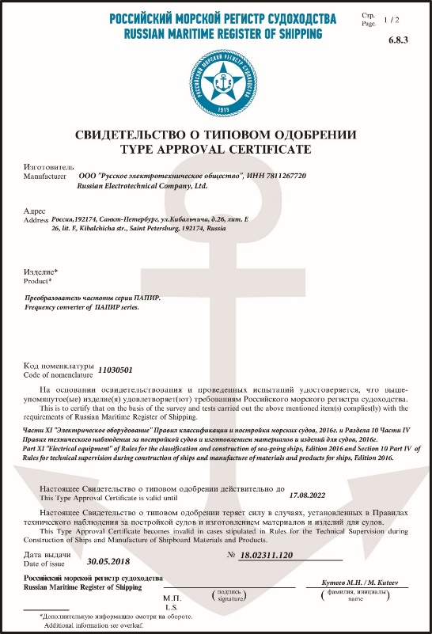
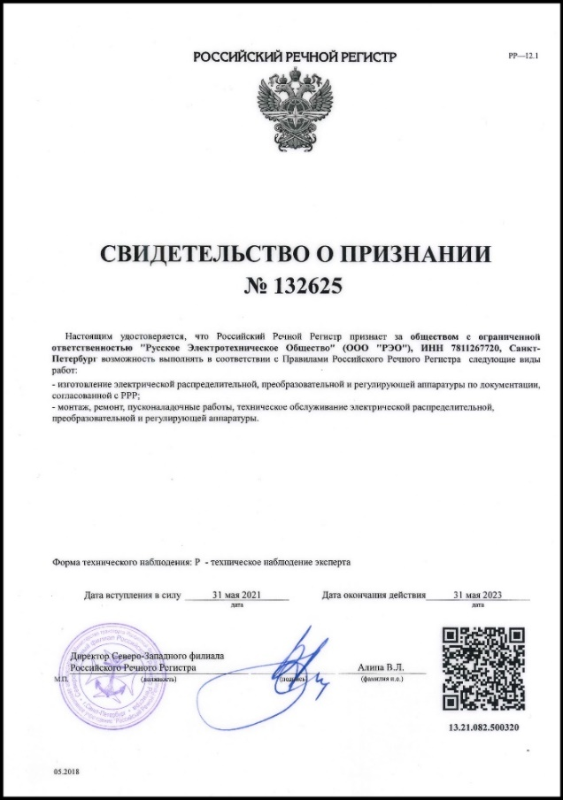
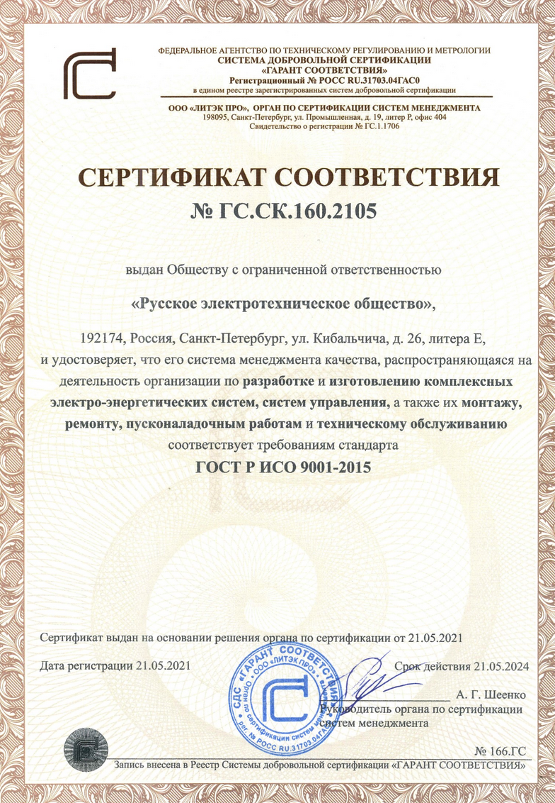
CERTIFICATES
“Certificate of Type Approval of the Russian Maritime Register of Shipping” dated 30/05/2018.
“Certificate of Recognition of RKO” Russian River Register dated 05/31/2021
“Certificate of Conformity GOST R ISO 9001-2015” dated
05/21/2021
03

Slide 4
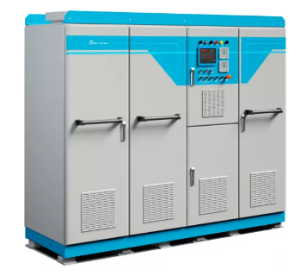
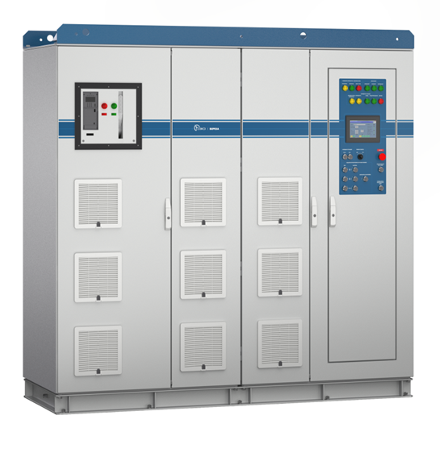


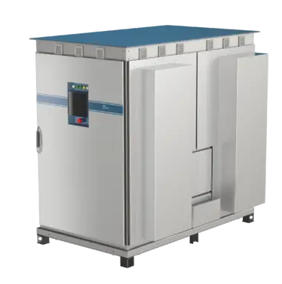
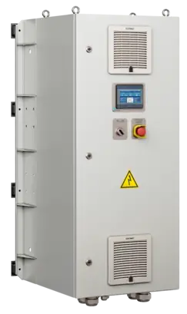
PRODUCTS
Bidirectional frequency converters
"PAPIR" series
DC 600-1200 V
AC 400 V
Power range from 1 to 5 MW
Series "BIRCH“
DC 600-1200 V
AC 400 kV
Power range from 500 to 900 kW
Frequency converters
Series "SUNFLOWER“
DC 1200 (1500) V
AC 660 (600) V
Power range from 1 to 5 MW
Series "INVERS“
DC 540 V
AC 400 V
Power range from 90 to 600 kW
04

Slide 5
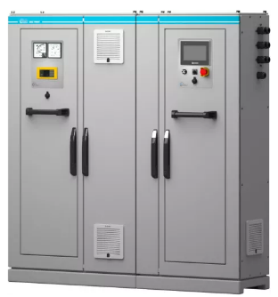
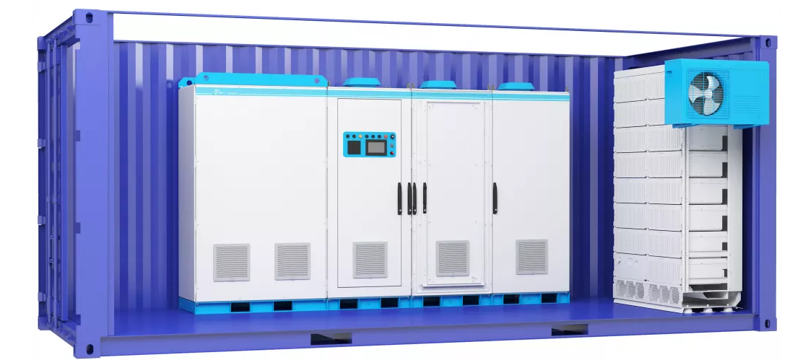
PRODUCTS
Unified electric power system of the Unified Energy System of the «TRANIT» series
Converter technology and storage devices are combined through a control system into a single complex, which, thanks to its advantages, allows to achieve a new level of functionality and reliability for the following application:
in electric transport;
in local energy distribution.
Dynamic voltage compensator «Canon»
A modern and effective solution to eliminate short-term voltage fluctuations (overvoltages, voltage sags) of relatively shallow depth. Canon is used in powerful power systems up to 1 MW.
05

Slide 6
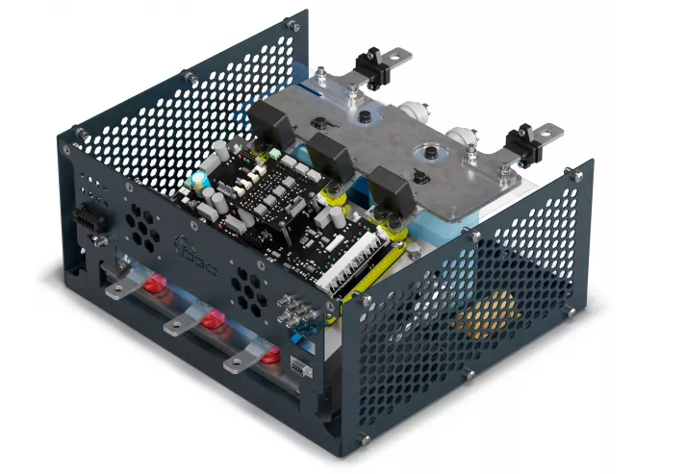
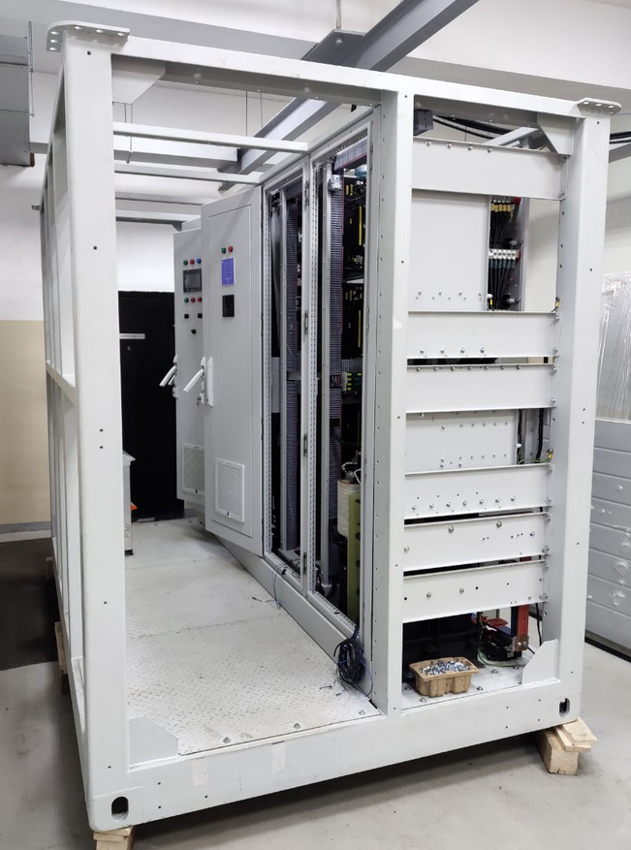
PRODUCTS
Power cell
The cell is designed for building power converters, such as:
frequency converters;
rectifiers;
inverters;
PWM controllers (DC/DC converters)
Ultrafast charging station «UFCS»
The UFCS is equipped with a unique automatic transfer switch (ATS) circuit and is designed for charging electric vehicles with different types of electric current, for instance:
River tram «Sinichka»;
Electric buses;
Electric cars.
06

Slide 7
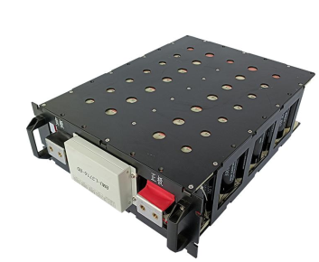
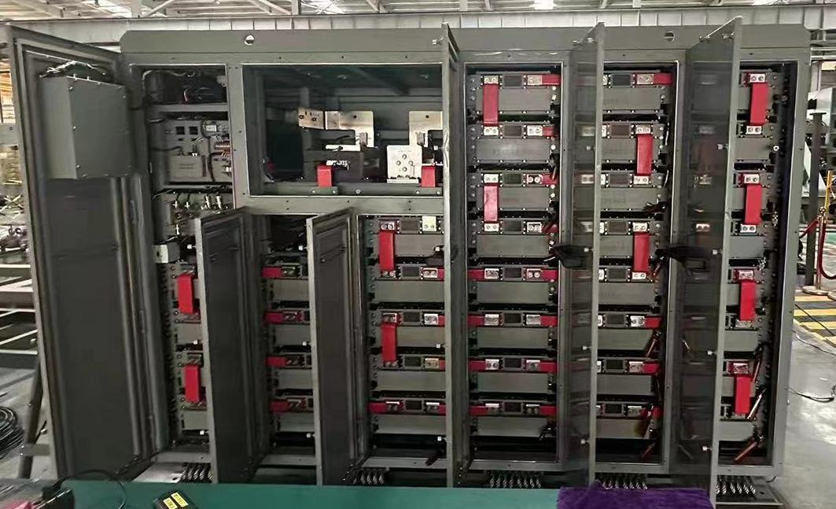
ENERGY STORAGES
Supercapacitor energy storage devices
High-power modular drive for energy storage and recovery systems with capacity and voltage scalability
Possibility of serial connection of modules up to 4400 V
Supports high energy and power processes
Instant response to dynamic changes in the electrical grid
Support for local generation of electrical energy during peak (second) loads
Ensuring power quality
Service life: ≥ 10 years, 1 million charge/discharge cycles
Operation in the temperature range from -40°С to +65°С
Maintenance free
Supercapacitor module 70,8F / 144 V
System of series-connected modules up to 4400 V
07

Slide 8
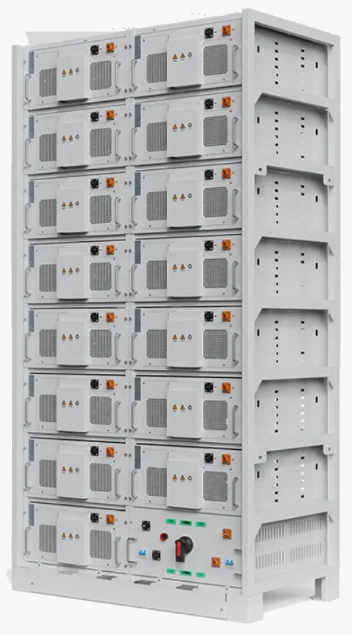
НАКОПИТЕЛИ ЭНЕРГИИ
Lithium-ion energy storage devices (LiFePo)
High-power modular Category A Li-ion drive for energy storage systems with the ability to scale in capacity and voltage
Possibility of serial connection of modules up to 1500 V;
Long lasting power support;
Instant response to dynamic changes in the electrical grid;
Support for local generation of electrical energy during peak (minute) loads;
Ensuring power quality;
Charge in the temperature range from - 0 °C to + 55 °C;
Discharge in the temperature range from - 20 °C to + 55 °C;
Self-discharge <3% for 1 month.
Storage device LiFePо, 280 А*H / 720 V
(201 kW*H)
08

Slide 9
DESIGN SOLUTIONS
Uninterruptible power supplies (online / offline)
Providing uninterrupted power supply to high-tech equipment using supercapacitor or li-ion drives
Application area:
Data centers;
Industrial enterprises;
Housing and communal services, etc.
Drives used:
Support time < 20 sec – supercapacitor storage devices;
Backup time > 20 sec – Li-ion drives.
Li-ion (LiFePo)
Power section
Supercapacitors
09

Slide 10
Uninterruptible power supply for the DC bus of the frequency-controlled drive (VCD DCB UPS)
As part of VCDs that power synchronous and asynchronous electric motors. The storage device used is supercapacitors (SC).
AC/DC
DC/AC
DCB
Advantages of product implementation
stabilization of voltage parameters of DC Bus of VCD in 400V Efficiency increased by eliminating additional conversion cycles
Compensation of the pulse component of the load and asymmetry in power grid and VCD load
Maintenance of critical technological processes in regular operation mode
long resource and service life (1 million charge-discharge cycles and service life of at least 10 years)
reduced operating costs, no costs for climate control systems
Maintenance-free, environmentally friendly scalable to work with multiple VCDs over a common DC bus and a common energy storage device
DC/AC
SC
10

Slide 11
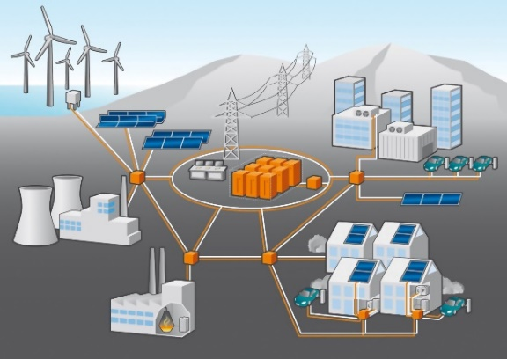
DESIGN SOLUTIONS
Energy routers for ensuring the operation of smart grids and micro grids
Redistribution of active load power between different (asynchronous) energy sources;
Peak load compensation using energy stored in the storage device balancing the load and compensating its reactive power in order to maintain an acceptable quality of network voltage 0.4 kV.
Effect of implementation
Reducing peak loads, leveling consumption schedules, release of extra power to connect new consumers.
The ability to connect to existing capacities.
Possibility of selling excess electricity to the grid, simplifying integration with distribution grids.
Streamlining the processes of transmission, distribution and consumption of electricity.
Exclusion from the power supply system:
ATR – automatic transfer of reserve
UPS – uninterruptible power supply
ESE – energy storage system
RPC – reactive power compensation device
load balancing equipment
Grid 1
Grid 2
11

Slide 12
DESIGN SOLUTIONS
Energy routers for ensuring the operation of smart grids and micro grids
Designed for:
Handling equipment;
Electric transport (metro, trams).
ICE
Generators
Rectifier (AC/DC)
Supercapacitor storage
G
Advantages of product implementation
Inverter (DC/AC)
G
CAPEX and OPEX savings up to 40% energy savings up to 30%, peak power up to 50%;
Increasing the service life of engines and braking systems;
Reducing the cost of their operations;
Possibility of operation under temperature conditions -40°С to +65°С;
Possibility of scaling, connection of additional equipment without the need to build new additional input power source.
Lifting motor
Gantry engines
Trolley engines
Auxiliary equipment
Energy for rise
Braking/lowering energy can be stored and used during lifting
Power(kW)
Time(s)
Energy lost when lowering/braking
12

Slide 13
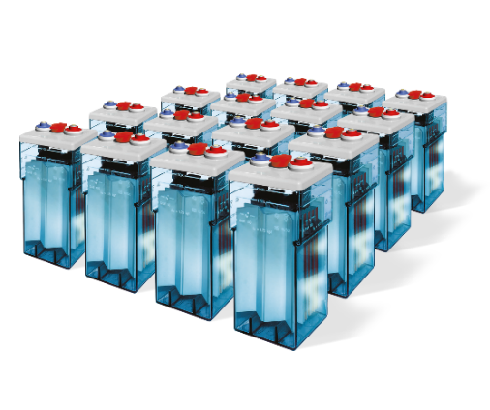
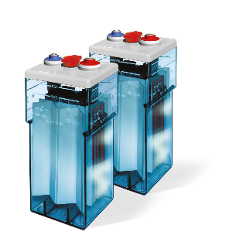
DESIGN SOLUTIONS
Supercapacitor storage device as part of operational direct current system (ODCS)
Advantages of product implementation
75
Reduced investment (Using the example of a substation with «ShPE-44»)
%
reduction of required battery capacity up to 90%;
reduction of capital investments in reconstructed substations by up to 75%;
eliminating the impact of impulse load on the battery, extending the service life of the battery up to 3 times;
protecting the power grid from voltage surges and dips;
significantly increasing fault tolerance and reducing accident rates;
providing instant response to power changes.
Thousands of rubles
Investments in batteries
Supercapacitors
Amount for a substation with a «ShPE-44» drive
13

Slide 14
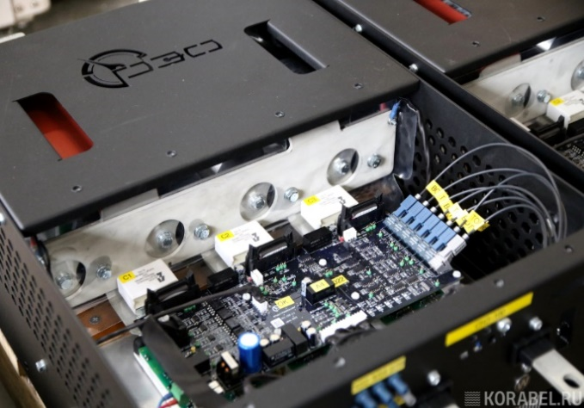
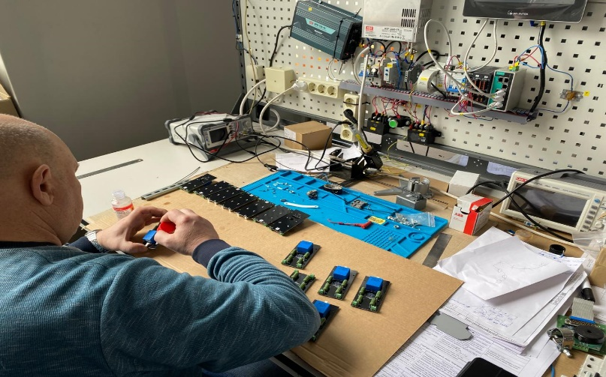
PCB manufacturing
«REC» Ltd. manufactures printed circuit boards. Professional equipment is used in production, and all procedures are performed in conditions prepared for this.
14

Slide 15
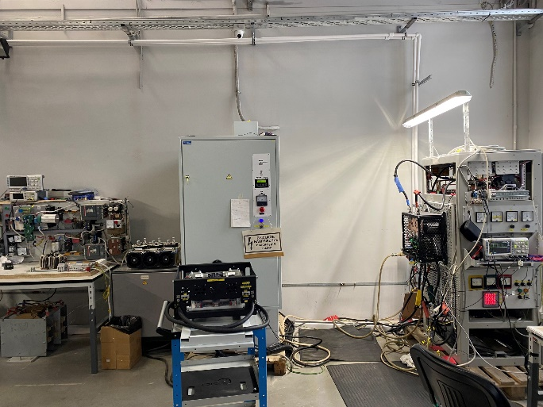
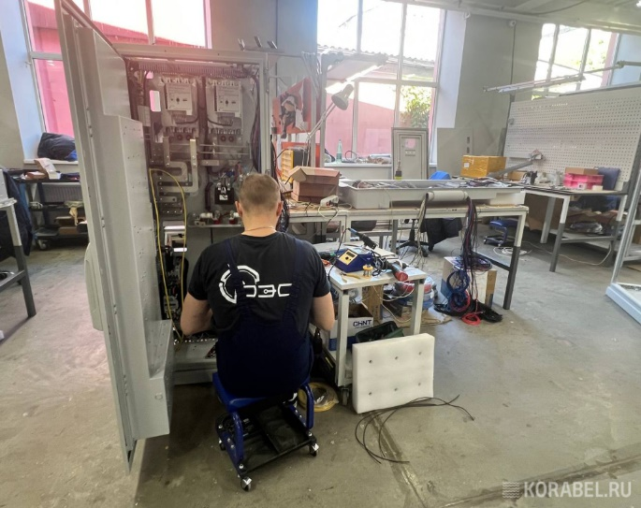
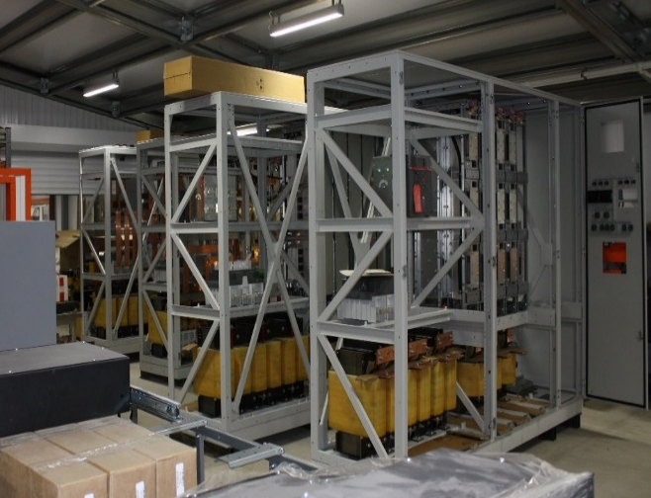
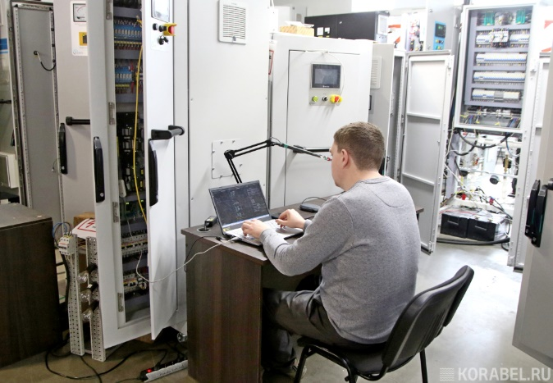
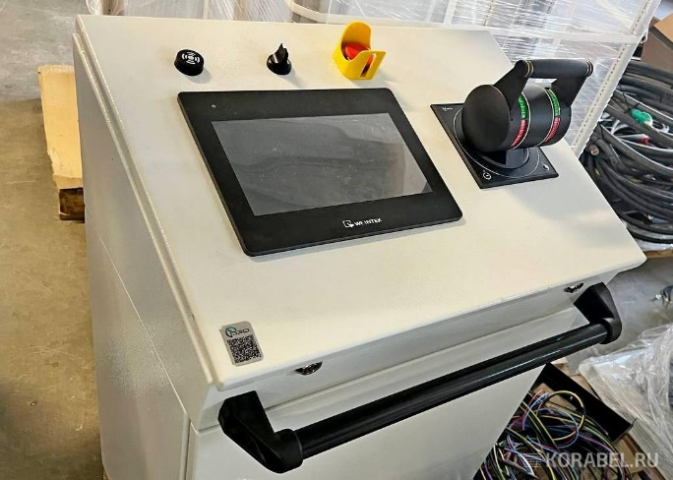
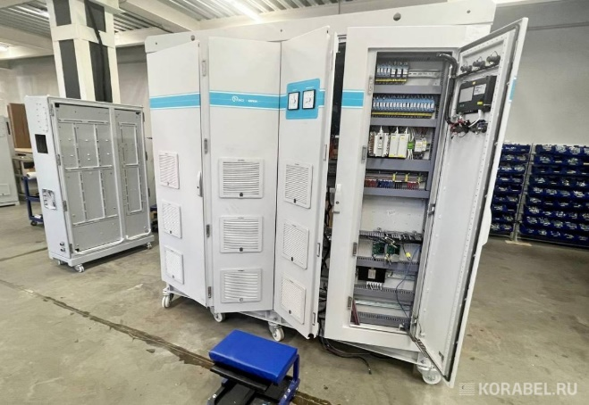
PRODUCTION
The equipment is manufactured on the basis of our own production
15

Slide 16
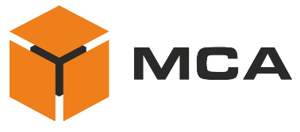













OUR CLIENTS
16

Slide 17

THANK YOU FOR YOUR ATTENTION
190020, St. Petersburg, emb. Obvodny Canal, 138, bldg. 4
Tel.: +7 (812) 313-77-73
ruselco.com
ruselco.com

